Slide 1

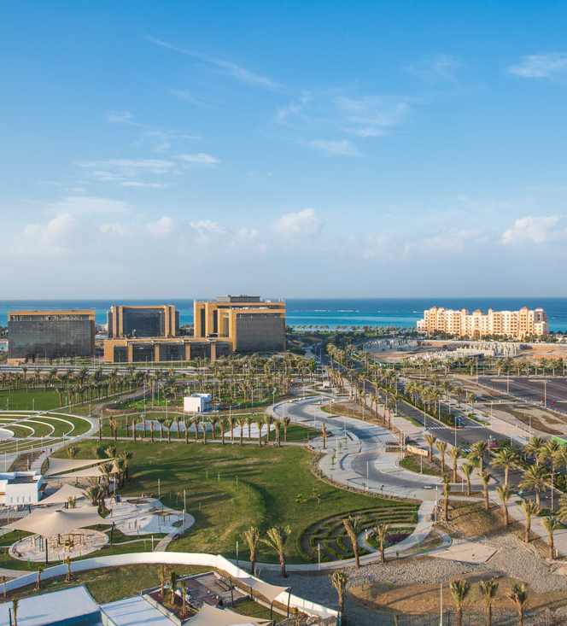
The Tourist Side Of KAEC

Slide 2
First Scene

Slide 3
Juman Park

Slide 4
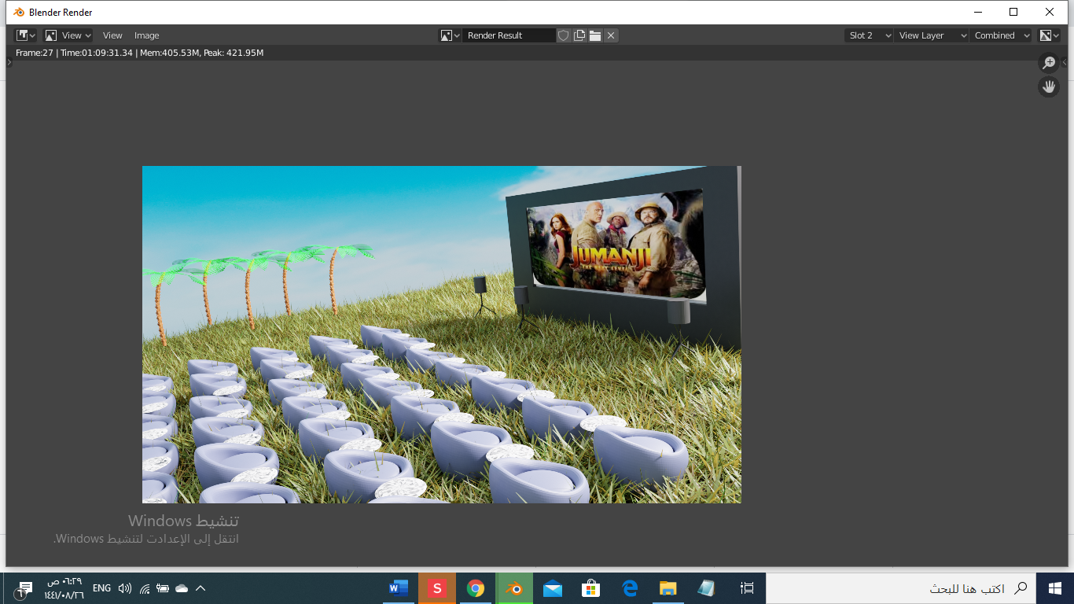
Beach Cinema

Slide 5
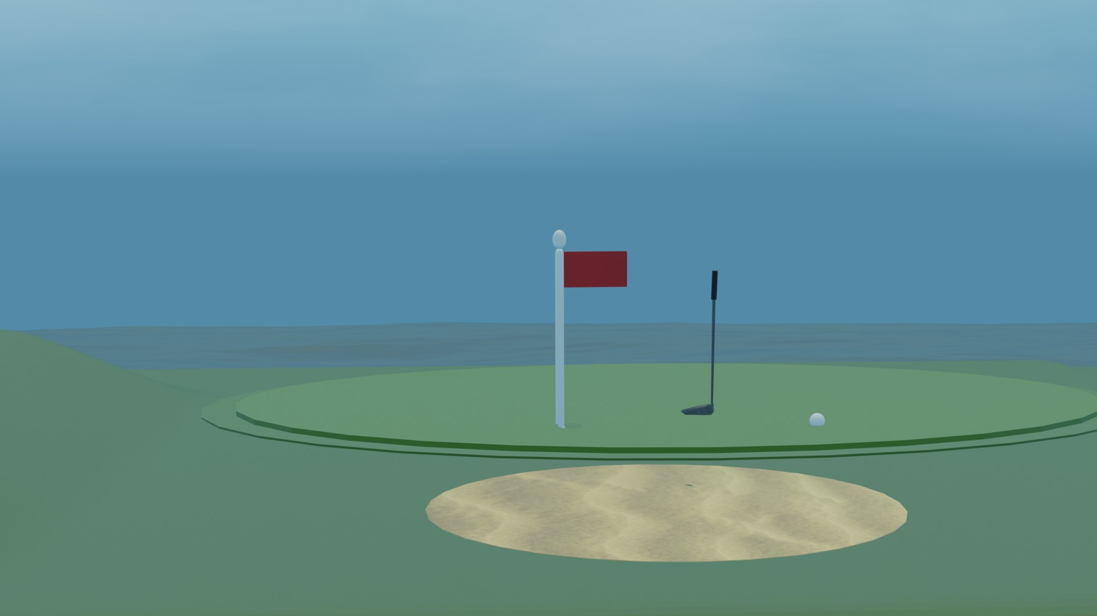
Golf Park

Slide 6
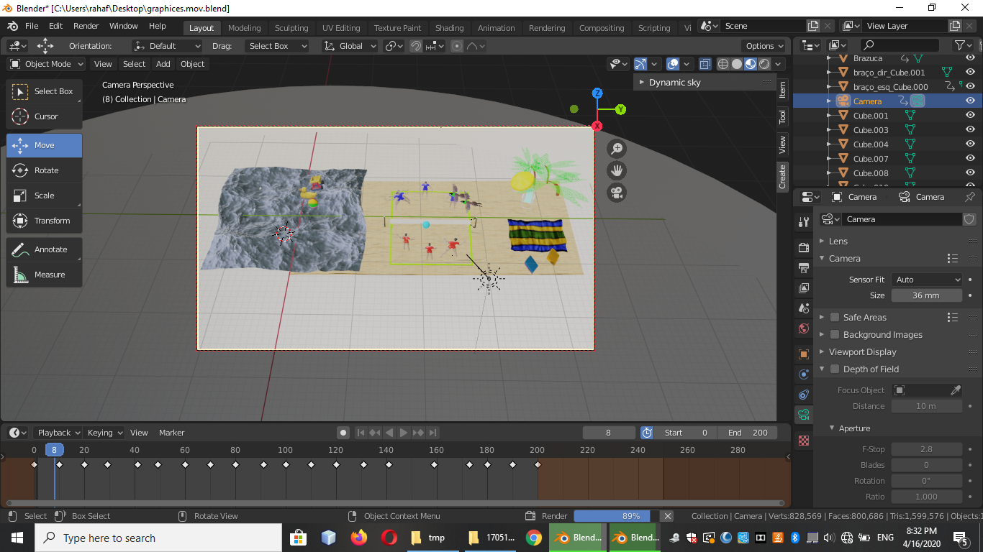
Beach walk

Slide 7
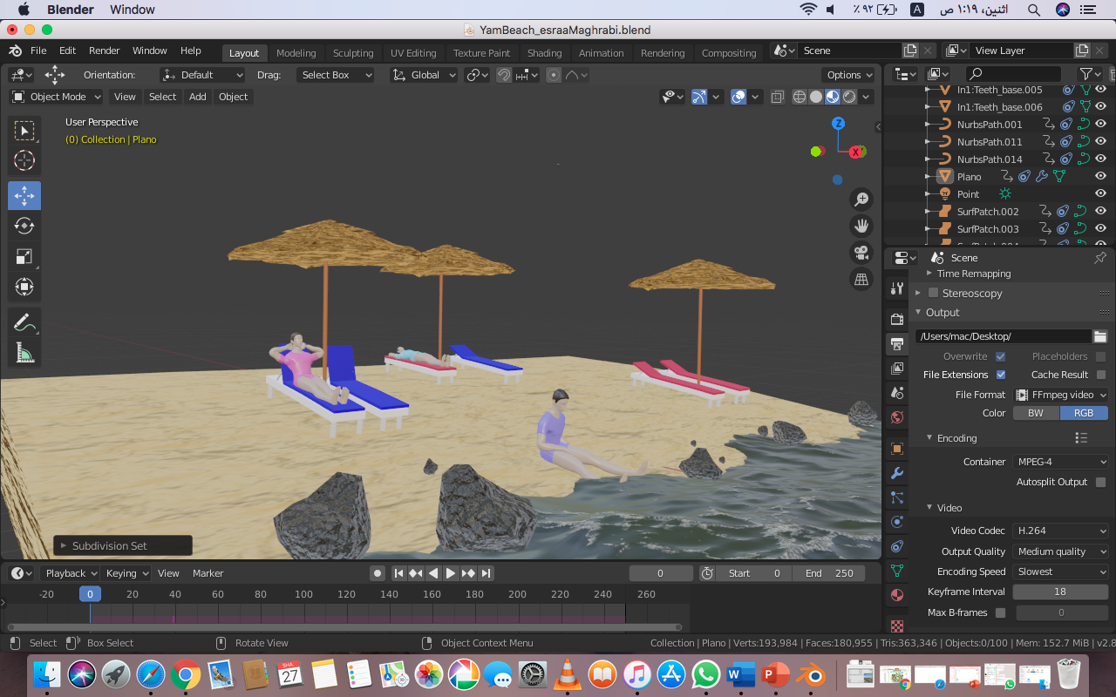
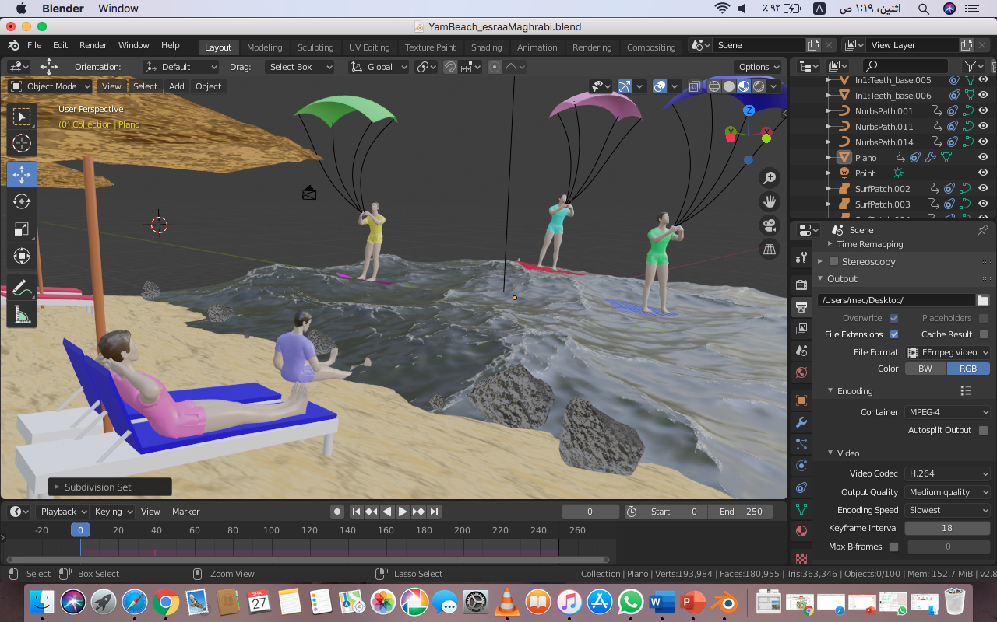
Yam Beach

Slide 8

Results

Slide 9
Name | ID | Section
Raneem Algrni | 1705312 | DAR ZZ
Asmaa Hakami | 1775369
Esraa Maghrabi | 1708297
Rahaf Alrowithi | 1705179
Sara Alhadrami | 1707422
Mahila Almutairi | 1706603

Slide 10


